Slide 1
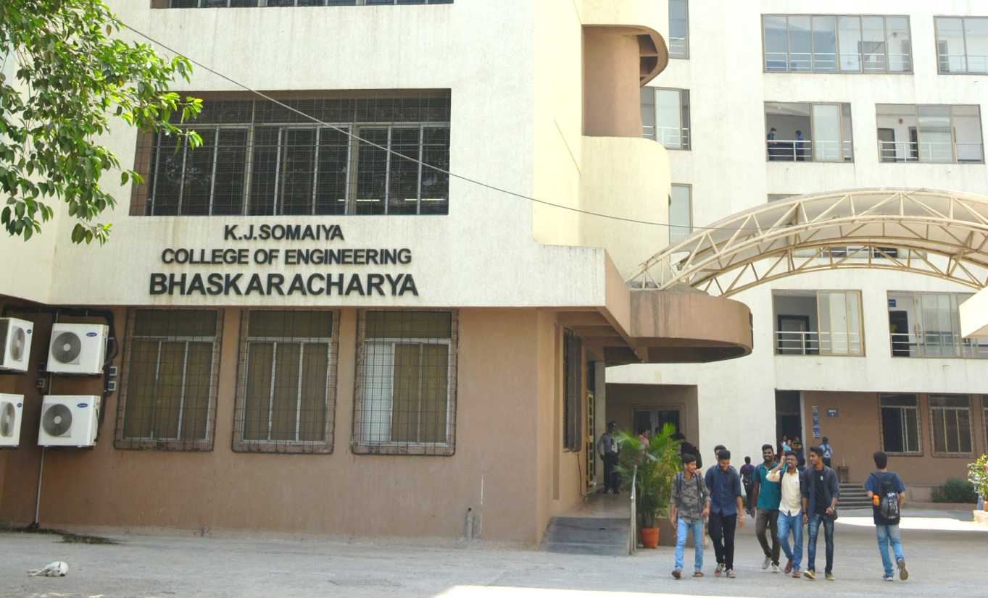
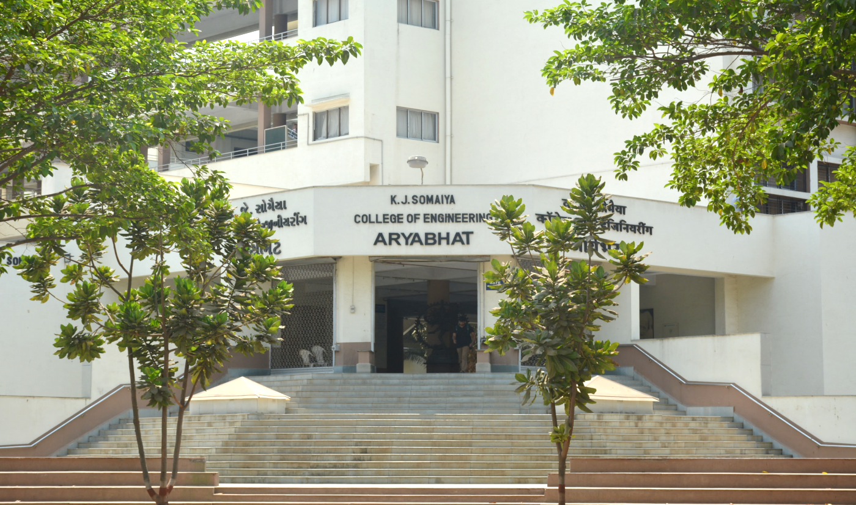
Automated Caption Generation for Jewelry Images using Deep Learning
Department of Information Technology

Slide 2
Automated Caption Generation for Jewelry Images using Deep Learning
Group ID: 4
Group Members:
Tanisha Mangaonkar - 16010422200
Prachi Gandhi - 16010422233
Chandana Galgali - 16010422234
Mahek Thakkar - 16010422235
Guide Details:
Name - Avani Sakhapara
Department - Information Technology

Slide 3
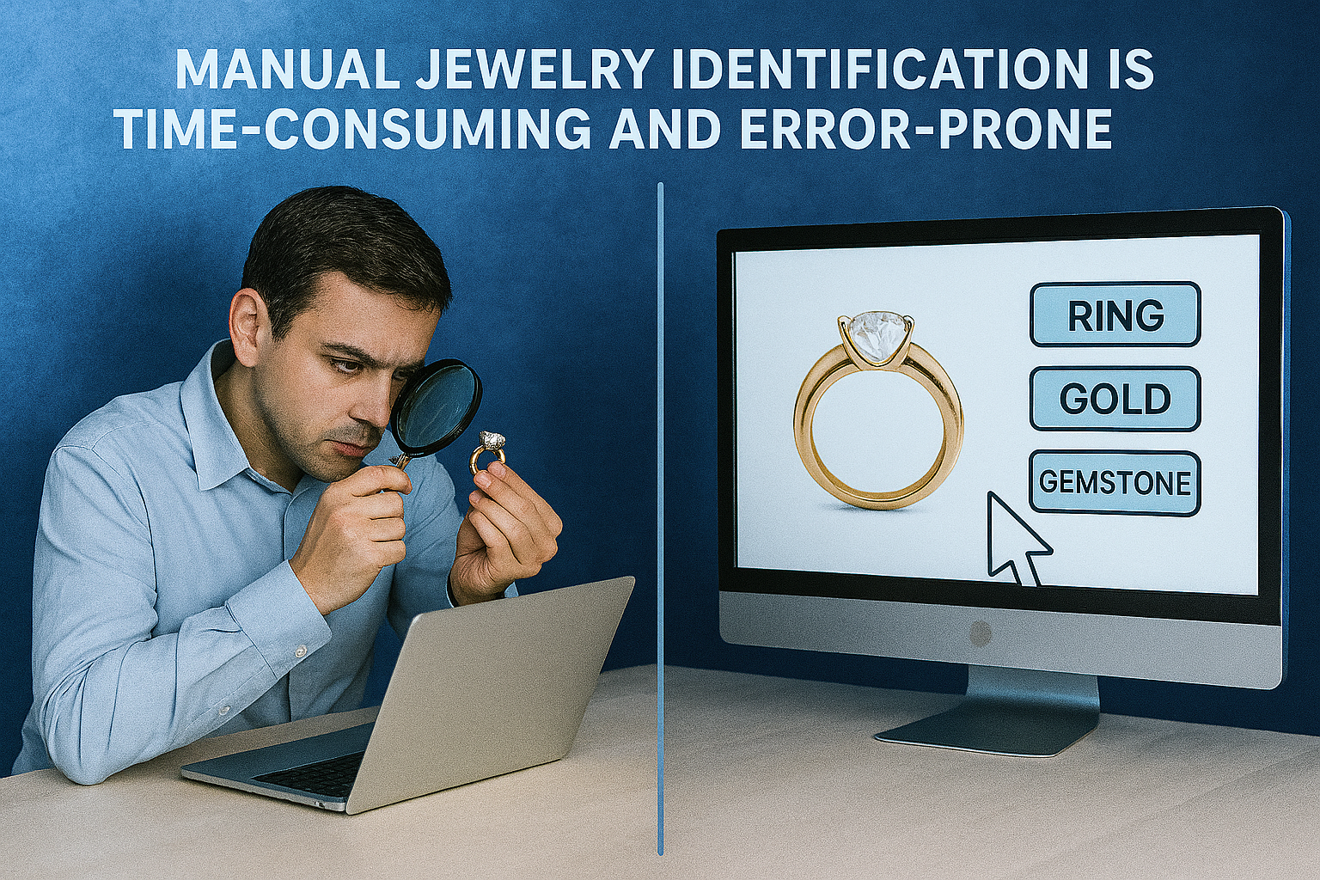
Need for the project
Manual jewelry identification is time-consuming and error-prone.
Existing systems only offer basic object detection without detailed understanding like metal colour, gemstone, etc.
Difficulties in maintaining accurate, searchable digital catalogs.

Slide 4
Problem Definition
Develop an automated system that detects necklaces and earrings from a person’s image, generates captions describing their metal colour, gemstones and classifies them based on presence of gemstones, metal colour, etc.

Slide 5
Background Work / Literature Survey
Jewelry Detection and Identification
General Object Detection and Tracking
Gemstone and Material Classification
Image Captioning

Slide 6
Background Work / Literature Survey
Jewelry Detection and Identification
Year | What is the paper about? (Aspects) | Methodology (Steps in 2-3 lines) | Datasets (Size, Type, etc.) | Results (Validation Metrics) | Advantages | Limitations | Reference No.
2024 | Uses image captioning for jewelry classification in e-commerce. | Used VGG-16 and MobileNet as CNN encoders, GRU and LSTM as RNN decoders to generate multi-level jewelry captions, followed by classification using parsed caption attributes. | Created a comprehensive jewelry image database from local jewelry stores. | Achieved high accuracy using VGG-16 + GRU with strong F1-scores. | Accurate and robust jewelry detection with end-to-end automated recognition, handling diverse styles and occlusions effectively. | Performance drops on similar-looking items like bracelets, relies on high-quality labeled datasets, and is limited to predefined jewelry categories. | [1]
2023 | Applies CNNs and Faster R-CNN for accurate image/video detection. | Used Faster R-CNN with a CNN backbone to extract features from Yakshagana images, applied region proposal networks (RPN) to locate small jewel regions, followed by ROI pooling and classification layers for precise jewel detection. | No detailed dataset info given; tested on public jewelry item datasets (implied). | Achieved high mAP and precision using Faster R-CNN for small jewel detection. | Faster R-CNN offers high precision, excels at detecting small jewelry items in complex images, and leverages deep learning adaptability for reliability. | Computationally intensive, needs large datasets, and is limited to Yakshagana-specific images. | [2]
2021 | Automates jewelry tagging via transfer learning and live feeds. | Created an image repository of jewelry, labeled images by category, trained a transfer learning model, and used OpenCV for real-time classification via live camera feed. | Used a manually created image repository of jewelry articles for training and validation. | Achieved accurate, real-time jewelry recognition with strong validation metrics. | Automates real-time jewelry tagging and classification using transfer learning, reducing manual errors, manpower, and enabling accurate live camera-based recognition. | Requires a large, well-labeled image repository, with performance heavily influenced by image quality and lighting, and may struggle with unseen jewelry types without retraining. | [3]

Slide 7
Background Work / Literature Survey
Jewelry Detection and Identification
Year | What is the paper about? (Aspects) | Methodology (Steps in 2-3 lines) | Datasets (Size, Type, etc.) | Results (Validation Metrics) | Advantages | Limitations | Reference No.
2025 | Proposes neural network for automatic jewelry description generation. | Used computer vision and various image captioning architectures, especially encoder-decoder models, trained on a comprehensive jewelry image database. | Built a large jewelry image dataset to train image captioning models. | Achieved high captioning accuracy with detailed descriptions of diverse jewelry. | Assists non-experts with detailed jewelry insights, generating accurate, hierarchical captions across varied styles. | Depends on image database quality, struggles with rare designs, and requires intensive training for captioning models. | [4]
2024 | Develops vision method to track gold necklaces for theft prevention. | Improved traditional Gaussian Mixture Model (GMM) with adaptive background subtraction (ABS) for enhanced detection and tracking of gold necklaces. | Used video/image sequences from gold shops for detection and tracking evaluation. | Achieved high frame tracking accuracy, outperforming the standard GMM method. | Tracks small, deformable objects effectively with ABS-enhanced accuracy, aiding theft prevention in gold shops. | Limited to shop settings, sensitive to occlusion and fast movement, and reliant on lighting and camera quality. | [5]
2023 | Presents mobile-friendly FC-YOLOv4 for fashion item detection. | Developed and compared a custom FC-YOLOv4 model with YOLOv3 and YOLOv4 using a dataset of 13,689 images across 10 categories, evaluated on mobile devices. | Dataset of 13,689 images covering five fashion and five accessories categories. | Achieved high mAP and IoU with reduced size and mobile efficiency. | Achieves extremely high accuracy (99.84% mAP), optimized for low-RAM mobile devices, and ensures faster detection for efficient e-commerce product categorization. | Limited to predefined categories, needs large labeled datasets, and performance varies across smartphone hardware. | [6]

Slide 8
Background Work / Literature Survey
Jewelry Detection and Identification
Year | What is the paper about? (Aspects) | Methodology (Steps in 2-3 lines) | Datasets (Size, Type, etc.) | Results (Validation Metrics) | Advantages | Limitations | Reference No.
2023 | Proposes jewelry retrieval using local HSV color histograms. | Extracted feature vectors from five local regions in HSV space, applied a classification module, and matched similarity scores for jewelry retrieval. | Used publicly available jewelry item retrieval datasets: ringFIR and Fashion Product Images. | Outperformed baselines on ringFIR and Fashion datasets in retrieval accuracy. | Effective in handling occlusion and shape deformation Lightweight and color-focused feature extraction Performs well on real-world jewelry datasets | Limited to HSV color space features May struggle with grayscale or low-color-contrast images Less robust compared to deep learning-based retrieval methods | [7]

Slide 9
Background Work / Literature Survey
General Object Detection and Tracking
Year | What is the paper about? (Aspects) | Methodology (Steps in 2-3 lines) | Datasets (Size, Type, etc.) | Results (Validation Metrics) | Advantages | Limitations | Reference No.
2023 | Compares YOLOv5–v7; YOLOv6 excels. | Created a custom jewelry dataset, applied data augmentation, and trained multiple YOLO versions to compare their small object detection performance. | Used a custom dataset of jewelry images captured from a jewelry store with data augmentation. | YOLOv6 outperformed YOLOv5/YOLOv7 in accuracy, F1, recall, and mAP. | Targets small object detection using a real-world jewelry dataset, comparing multiple YOLO versions and highlighting YOLOv6’s superior performance. | Dataset covers only three jewelry classes, limiting generalization, and lacks full exploration of real-time deployment challenges. | [8]
2023 | Proposes CNN-YOLOv7 for jewelry in smart stores. | Uses a CNN-based YOLOv7 model trained on a custom jewelry dataset for accurate detection and localization of small jewelry objects in smart store surveillance. | Used a unique dataset curated specifically for smart store surveillance focused on jewelry. | Achieved strong metrics on custom data using YOLOv7 for lightweight surveillance. | Designed for detecting small, intricate objects in surveillance, this lightweight model delivers high accuracy and real-time efficiency on custom jewelry datasets. | Primarily focused on jewelry, limiting generalization; may struggle in cluttered or low-light settings and needs a specialized dataset for training. | [9]
2022 | Reviews YOLO/CNN for real-time detection. | Surveyed and analyzed YOLO algorithm versions and CNN architectures for real-time object detection and feature extraction. | No original dataset; it’s a review of YOLO and CNN models applied in literature. | Reported higher mAP and FPS, showing YOLO's real-time detection advantage. | Offers high accuracy and real-time speed with efficient CNN-based detection, enabling broad industrial applicability. | May underperform on small or overlapping objects, needs significant computational resources, and relies on high-quality training data. | [10]

Slide 10
Background Work / Literature Survey
General Object Detection and Tracking
Year | What is the paper about? (Aspects) | Methodology (Steps in 2-3 lines) | Datasets (Size, Type, etc.) | Results (Validation Metrics) | Advantages | Limitations | Reference No.
2023 | Proposes YOLO-based system for ring and earring detection in smart shops. | Trained and validated a YOLO-based object detector on a custom dataset of rings and earrings for real-time monitoring in smart shop surveillance systems. | Used a customized dataset containing rings and earrings images. | Achieved real-time, accurate detection with strong mAP and localization metrics. | Enables real-time jewelry monitoring in smart shops with high accuracy using a lightweight, efficient YOLO architecture. | Limited to only two jewelry classes (rings and earrings) May require retraining for different store layouts or lighting conditions | [11]
2021 | Surveys DL models, datasets, and edge suitability. | Reviewed and compared deep learning-based object detection models using benchmark datasets, evaluation metrics, and backbone architectures, including lightweight models for edge deployment. | No specific dataset used; it’s a survey paper reviewing existing models and benchmarks. | Compared detectors using mAP, FPS, and parameters for accuracy and efficiency. | Covers modern object detection models, benchmark datasets, and metrics, with insights on lightweight models and performance comparisons. | Lacks original experiments, relies solely on literature analysis, and may miss post-2021 advancements. | [12]
2023 | Compares CNN and transformer models for object detection. | Conducted a comparative analysis of CNN and transformer architectures for object detection, focusing on design, performance, and attention mechanisms. | Literature review; no dataset used. | Provided literature-based insights without experimental metrics or validation. | Provides a thorough overview of CNN and transformer-based detectors, highlighting the shift to attention models and outlining emerging research trends. | Purely literature-based without experimental validation, lacks quantitative benchmarks, and may miss the latest transformer model developments. | [13]

Slide 11
Background Work / Literature Survey
Gemstone and Material Classification
Year | What is the paper about? (Aspects) | Methodology (Steps in 2-3 lines) | Datasets (Size, Type, etc.) | Results (Validation Metrics) | Advantages | Limitations | Reference No.
2023 | Proposes CNN-RF model for gemstone ID using curated images. | Used CNN for feature extraction from gemstone images and integrated a Random Forest classifier for final classification, trained on a 6265-image dataset with a 70:30 split. | Dataset of 6,265 gemstone images with 70:30 train-test split. | Achieved strong classification accuracy for effective gemstone identification. | Combines strengths of deep learning and traditional ML Works well on a moderate-sized dataset Applicable to geological and mineralogical domains | Accuracy (~74.76%) leaves room for improvement Performance may degrade on unseen gemstone types Limited dataset diversity may affect generalization | [14]
2024 | Uses CNN-LSTM with LIBS to classify jewelry rocks. | Applied CNN layers for feature extraction from LIBS data and LSTM layers for sequence modeling, with interpretability analysis and Lasso feature selection. | Used laser-induced breakdown spectroscopy (LIBS) data from different jewelry rock samples. | Achieved high accuracy in classifying jewelry rocks using deep learning and LIBS. | Combines spectroscopy with interpretable deep learning High accuracy in classifying diverse jewelry rock types Provides layer-wise model interpretability | Requires specialized LIBS equipment May be limited to types of rocks studied Computationally intensive due to hybrid CNN-LSTM architecture | [15]

Slide 12
Background Work / Literature Survey
Image Captioning
Year | What is the paper about? (Aspects) | Methodology (Steps in 2-3 lines) | Datasets (Size, Type, etc.) | Results (Validation Metrics) | Advantages | Limitations | Reference No.
2023 | Explores how image captions enhance multimodal datasets for vision-language training. | Used synthetic captions from image captioning models and mixed them with raw web data, evaluating different strategies on a 128M image-text dataset. | Used large-scale web-scraped image-text datasets (128M and 1.28B pairs). | Outperformed prior filters on ImageNet, 38 tasks, Flickr, and MS-COCO. | Improves dataset quality without sacrificing diversity Boosts performance across multiple benchmarks Demonstrates scalable benefits on 1.28B image-text pairs | Synthetic captions may have limitations at very large scales Standard captioning benchmarks don’t predict real training utility Image curation becomes increasingly critical with dataset size | [16]

Slide 13
Outcomes of Background Work / Literature Survey
Manual jewelry identification is slow and error-prone.
Existing systems don’t provide detailed descriptions like metal colour, gemstone, etc.
Models like YOLO and BLIP can automate detection and generate meaningful captions for jewelry.
AI can help preserve traditional jewelry by recognizing and describing cultural designs.
Most models focus only on detection and ignore semantic understanding.

Slide 14
Scope - Functional Requirements
Accept input image of person wearing necklace and/or earrings
Detect and identify necklaces and earrings in the image using a YOLO model and a CNN classifier
Generate captions detailing metal colour and gemstones using a BLIP model (Vision-Language Model)
Output structured descriptions and classifications for each detected item
Provide a user interface for image upload and result display

Slide 15
Scope - Non-Functional Requirements
Accuracy: The system must accurately detect and classify jewelry items with high precision.
Performance: The system should process images and deliver results promptly to ensure a smooth and efficient user experience.
Usability: The interface should be simple and user-friendly for non-technical users like jewellers.

Slide 16


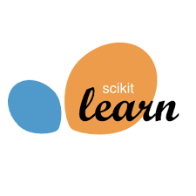



Technologies to be Used
Frontend UI
React framework for user interface
Detection & Classification
YOLO v5 - Jewelry detection
OpenCV 4.7+ – Image processing
Pillow 9.5+ – Image handling
Feature Extraction
PyTorch 2.0+ / TensorFlow 2.12+ – Model inference
scikit-learn 1.2+ – Label encoding
Image Captioning
Transformers 4.32+ – Pretrained LLMs
PyTorch 2.0+ – Caption generation backend
BLIP – Vision-language models

Slide 17
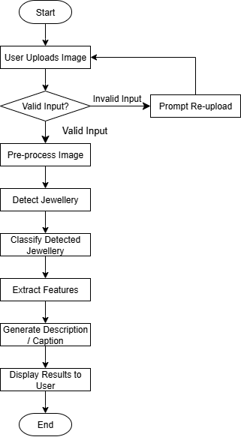
Overview Of Implementation
Flowchart showing the system workflow, beginning with an image uploaded by the user and moving through jewelry identification, type classification (such as necklace or earring), visual feature analysis, and automatic description generation, ending with result display and an optional retry step based on user feedback.

Slide 18
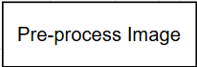
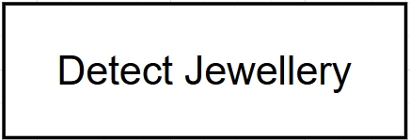
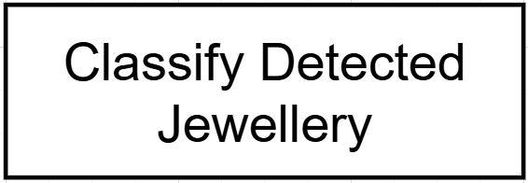
Overview Of Implementation
Preprocessing the Input Image:
OpenCV 4.7+ → Resizing, noise reduction, image enhancement.
Pillow 9.5+ → Load, crop, convert image format (e.g., PNG to RGB).
Ensures a clean and consistent image for model input.
Jewelry Detection & Classification:
PyTorch 2.0+ & Torchvision 0.15+ → Deep learning framework and pretrained detection models (e.g., YOLO v5).
Object detection locates jewelry regions (bounding boxes).
CNN classifier distinguishes between necklace and earring.
Segments and labels jewelry for further analysis.

Slide 19
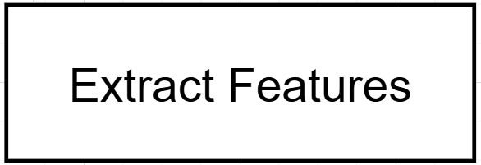
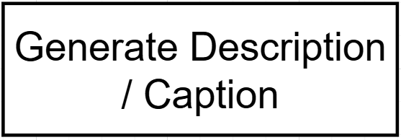
Overview Of Implementation
Feature Extraction:
PyTorch 2.0+ / TensorFlow 2.12+ → Run models to analyze jewelry features (e.g., ResNet).
Extract features like: Metal color, Gemstone presence.
scikit-learn 1.2+ → Encodes and structures features for captioning.
Captures the visual and structural traits of each jewelry item.
Caption Generation:
BLIP (vision-language models) → Generate descriptive text.
Transformers 4.32+ → Access pretrained LLMs.
PyTorch 2.0+ → Runs the captioning backend.
Output: “A round necklace with emerald green gemstones set in yellow gold.”
Combines visual understanding and language for accurate descriptions.

Slide 20
Implementation Schedule
Task | Timeline
Problem Statement Refinement & Literature Review | July 14 – July 31
Dataset Collection & Curation | August 1 – August 15
Image Preprocessing | August 16 – August 31
Model Design and Training | September 1 – September 30
Model Fine-tuning | October 1 – October 15
Frontend-Backend Integration | October 16 – October 31
Final Testing & Error Analysis | November 1 – November 20
Deployment on Vercel & Documentation | November 21 – December 5

Slide 21
References
S. S. A. Zaidi, M. S. Ansari, A. Aslam, N. Kanwal, M. Asghar, and B. Lee, “A Survey of Modern Deep Learning based Object Detection Models,” arXiv preprint, arXiv:2104.11892v2, May 2021.
M. Mafaz, “Identification of Jewelry Article using Transfer Learning and Image Repository,” International Journal of Advance Research, Ideas and Innovations in Technology (IJARIIT), vol. 7, no. 4, 2021.
V. Viswanatha, R. K. Chandana, and A. C. Ramachandra, “Real Time Object Detection System with YOLO and CNN Models: A Review,” Journal of Xi'an University of Architecture & Technology, vol. 12, no. 4, 2020.
L. Yang, “Investigation of You Only Look Once Networks for Vision-based Small Object Detection,” International Journal of Advanced Computer Science and Applications (IJACSA), vol. 14, no. 4, 2023.
W. Ni, “Implementation of a CNN-based Object Detection Approach for Smart Surveillance Applications,” IJACSA, vol. 14, no. 12, 2023.
A. Murthy, P. Devadiga, and N. P. S., “FASTER R-CNN Approach for Detecting Smaller Jewels in Yakshagana Image,” International Research Journal of Modernization in Engineering, Technology and Science (IRJMETS), vol. 5, no. 6, Jun. 2023.
W. Xu and Y. Zhai, “A YOLO-based Object Monitoring Approach for Smart Shops Surveillance System,” Journal of Optics, vol. 53, pp. 3163–3170, 2024.
Y. Thwe, N. Jongsawat, and A. Tungkasthan, “Accurate Fashion and Accessories Detection for Mobile Application based on Deep Learning,” International Journal of Electrical and Computer Engineering (IJECE), vol. 13, no. 4, pp. 4347–4356, Aug. 2023.
T. Nguyen, S. Oh, S. Y. Gadre, G. Ilharco, and L. Schmidt, “Improving Multimodal Datasets with Image Captioning,” in Proc. 37th Conf. Neural Information Processing Systems (NeurIPS), 2023.
S. Shah and J. Tembhurne, “Object detection using convolutional neural networks and transformer-based models: a review,” Journal of Electrical Systems and Information Technology, vol. 10, no. 1, 2023.
A. M. Shoib, S. Jabeen, C. Wang, and A. Tassawar, “Content-based Jewellery Item Retrieval using the Local Region-based Histograms,” arXiv preprint, arXiv:2305.07540v1, May 2023.
Yashu, V. Kukreja, K. Madan, A. Singh, and D. Kumar, “GemID: A Hybrid CNN-Random Forest Approach for Accurate Gemstone Identification,” in Proc. 3rd Int. Conf. Smart Generation Computing, Communication and Networking (SMART GENCON), Dec. 2023, pp. 1–6.
J. M. Alcalde-Llergo, E. Yeguas-Bolívar, and A. Fuerte-Jurado, “Jewelry Recognition via Encoder-Decoder Models,” arXiv preprint, arXiv:2401.08003v1, Jan. 2024.
A. Thanakrirkphon and S. Mruetusatorn, “Detection and Tracking Shape-Shifting Gold Necklaces Using Computer Vision Techniques,” in Proc. IEEE Conf., 2023.
P. Khalilian et al., “Jewelry rock discrimination as interpretable data using laser-induced breakdown spectroscopy and a convolutional LSTM deep learning algorithm,” Scientific Reports, vol. 14, Art. no. 5169, 2024.
J. M. Alcalde-Llergo et al., “Automatic Identification and Description of Jewelry Through Computer Vision and Neural Networks for Translators and Interpreters,” Applied Sciences, vol. 15, no. 10, Art. no. 5538, 2025.

